Slide 1
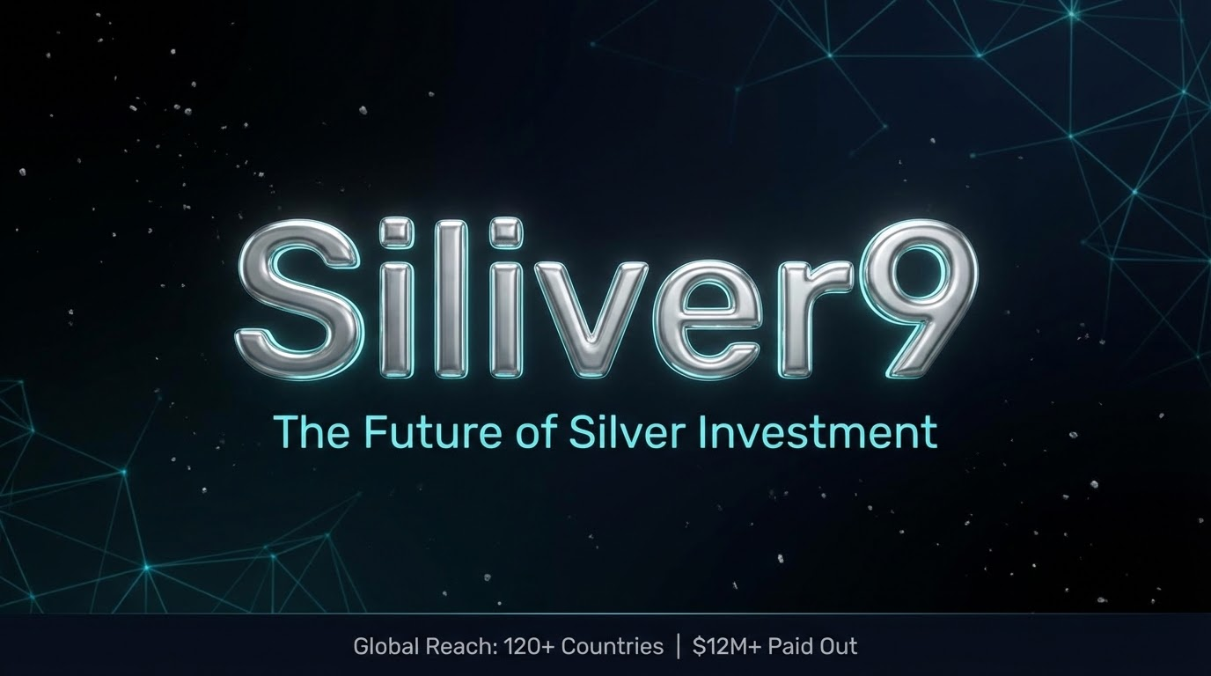



Siliver9
The Future of Silver Investment
Global Reach: 120+ Countries | $12M+ Paid Out
Notes:
Welcome to Siliver9. We are a premium precious metals trading platform operating in over 120 countries with over 50,000 active investors.

Slide 2
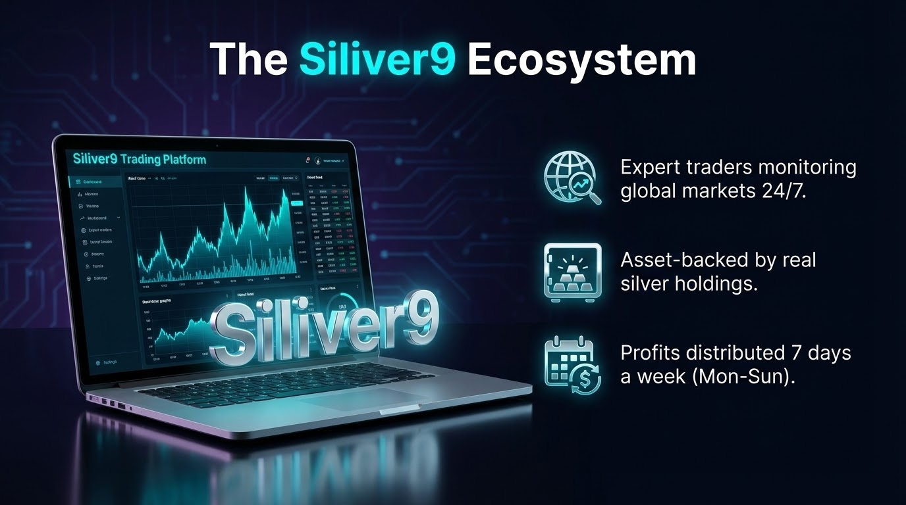

Slide 3
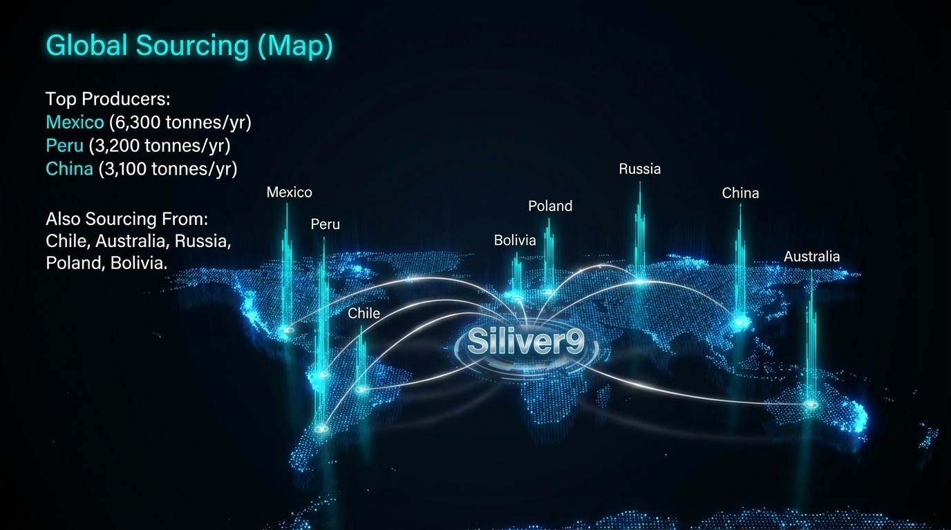

Slide 4
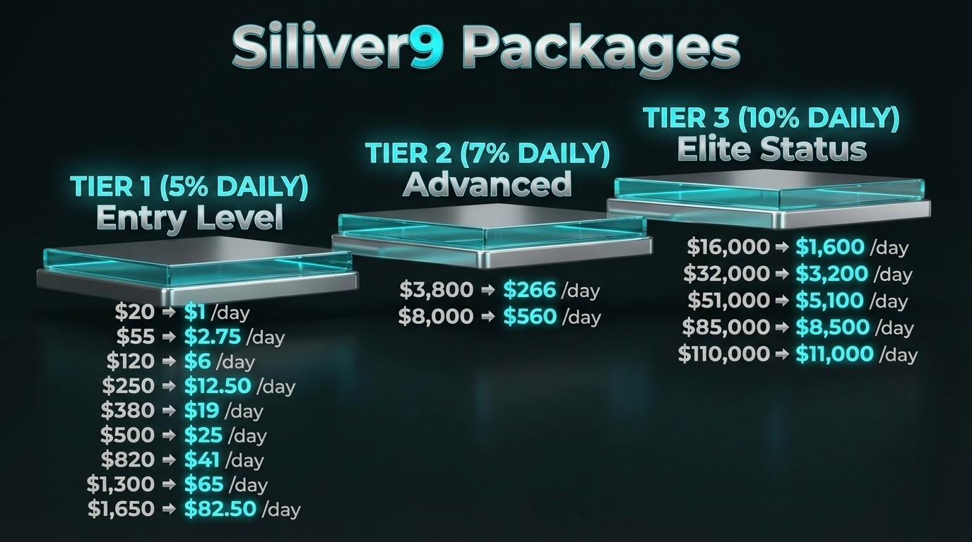

Slide 5
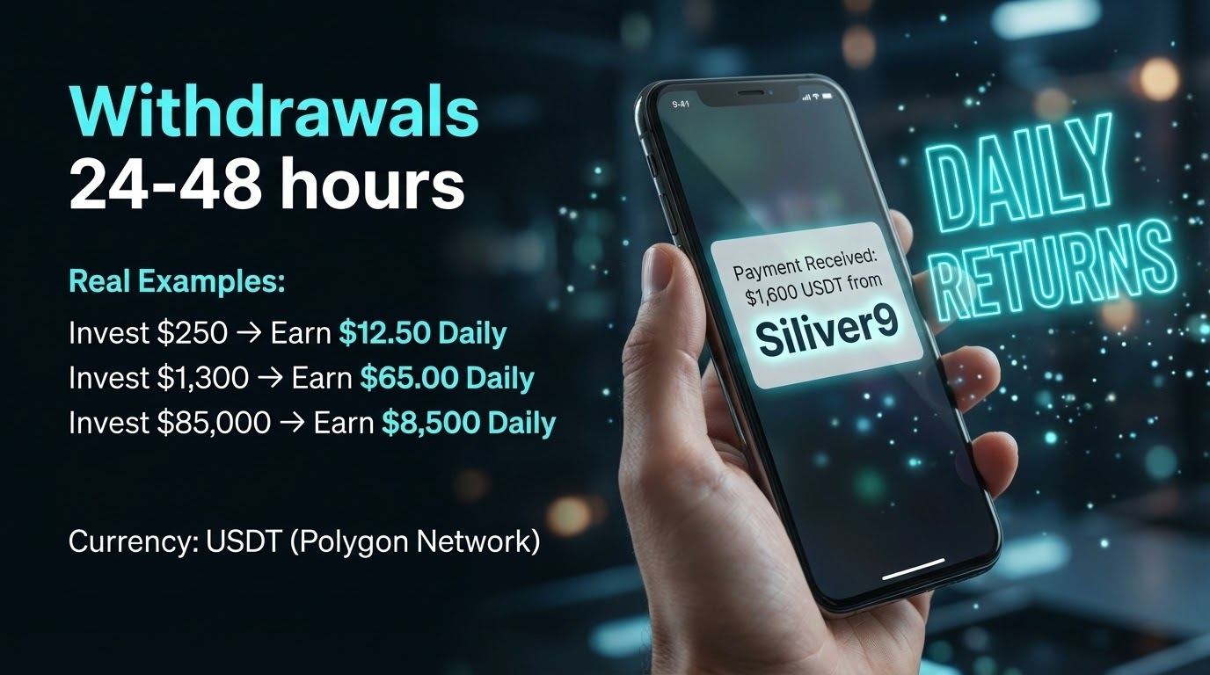

Slide 6
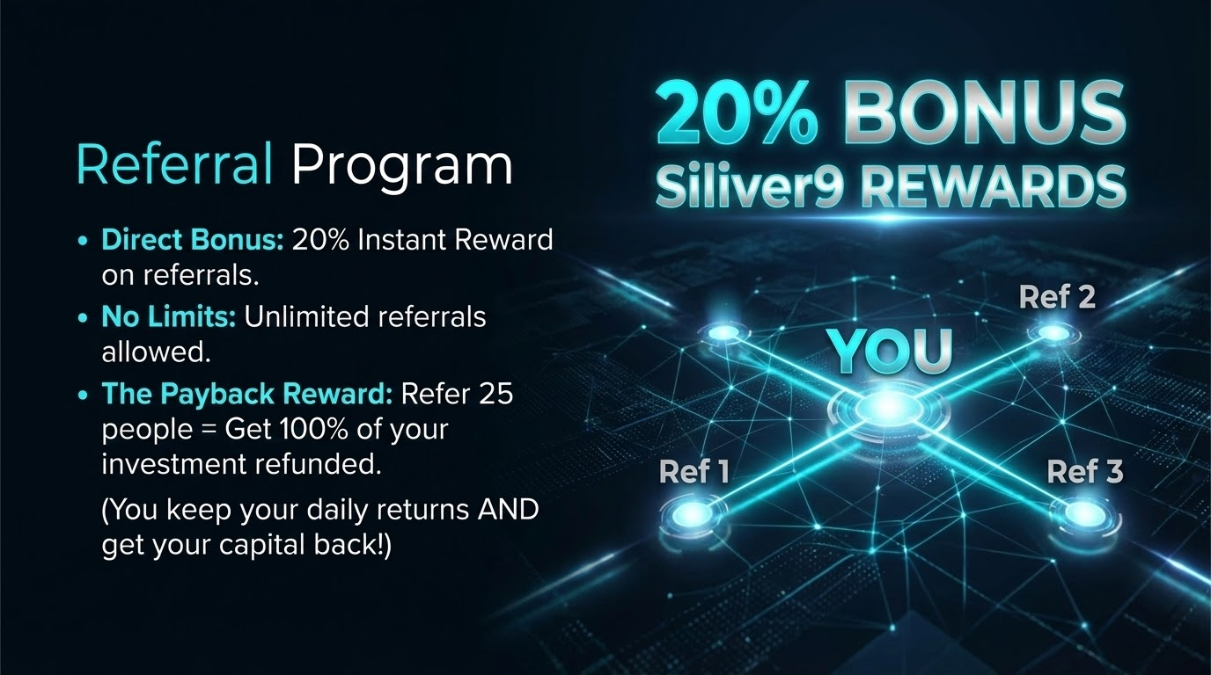

Slide 7


Slide 8
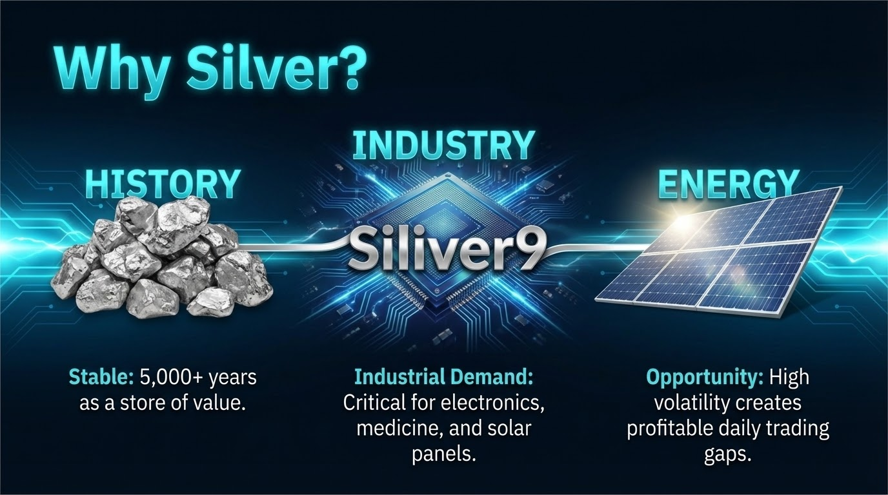

Slide 9


Slide 10


